Slide 1
PSPE 2014 Fall Callout
PLEASE SIGN IN AS YOU COME IN
Notes:
Speaker: Riley

Slide 2
PSPE Background
Notes:
Speaker: Riley

Slide 3

What is PSPE?
PSPE stands for the:
Purdue
Society of
Professional
Engineers
Student chapter of:
National Society of Professional Engineers (NSPE)
Indiana Society of Professional Engineers (ISPE)
A.A. Potter Chapter of ISPE (west central Indiana)
Notes:
Speaker: Riley

Slide 4
Who are we?
Officers:
Riley Barta – President
Kyle McNulty – Vice President
Jon Baker – Treasurer
Morgan Joel – Secretary
Committee Chairs:
Patrick Miner – Events
Andrew Griffith – Service/Social
Mayank Makkar – Research Roundtable
Udit Vyas – MathCounts and Order of the Engineer
Faculty Advisors:
Dr. Vincent Drnevich, PE – Professor Emeritus of Civil Engineering
Dr. Brophy – Ph.D. - Associate Prof. of Engineering Education
Notes:
Speaker: Officers listed (Riley covers faculty advisors)

Slide 5
What is Our Mission?
Promote excellence in engineering
Encourage professionalism and professional registration
Serve as a student advisory body to the Schools of Engineering Administration
Promote awareness of career opportunities and the role of PE’s in society
Produce integrated extracurricular activities
Oversee the PSPE Rube Goldberg Team
Notes:
Speaker: Kyle

Slide 6
Committees
Notes:
Speaker: Patrick

Slide 7

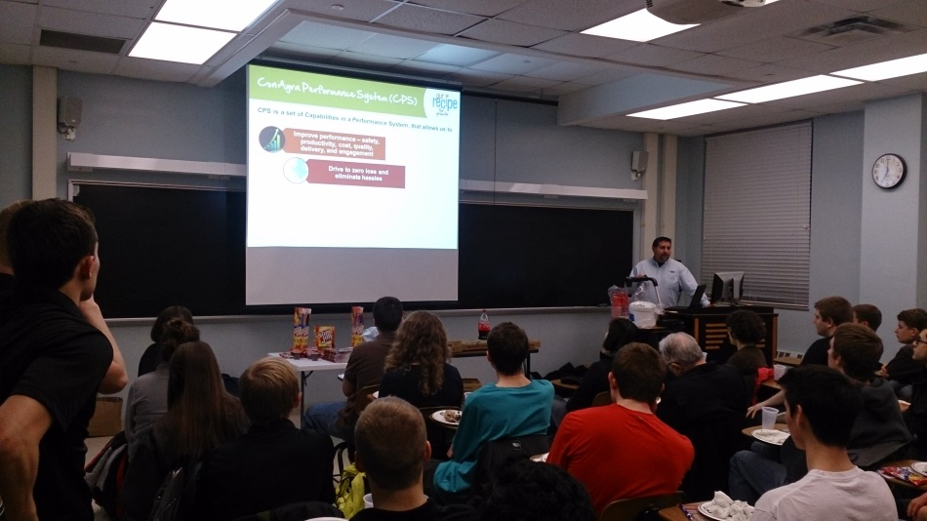

Events Committee
Arranges speakers for all membership meetings
Advertises PSPE events
Aides in the organization OE and MathCounts
Notes:
Speaker: Patrick

Slide 8
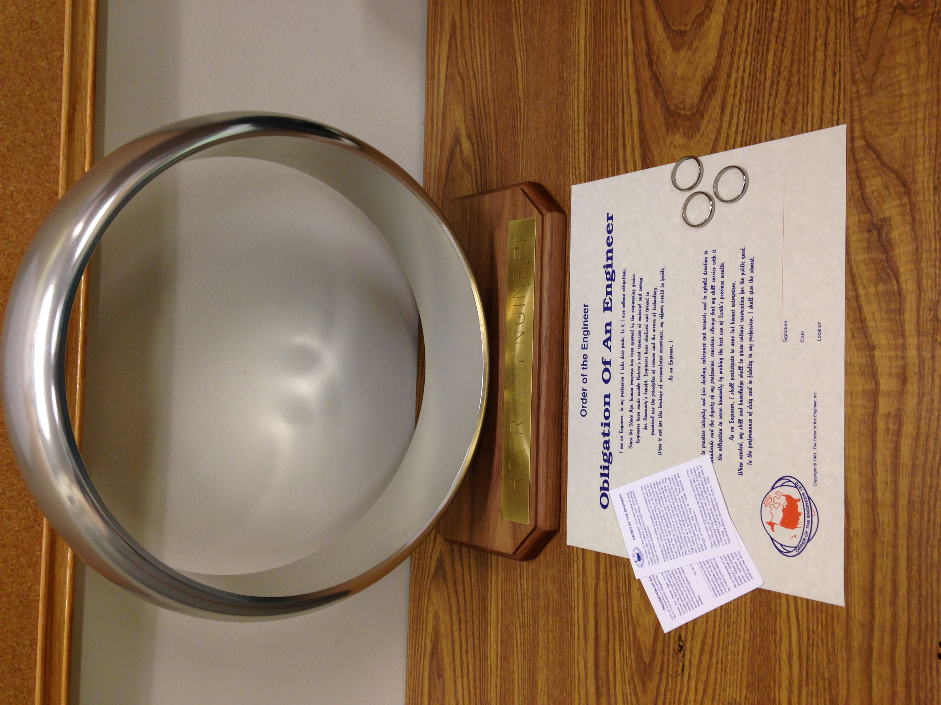
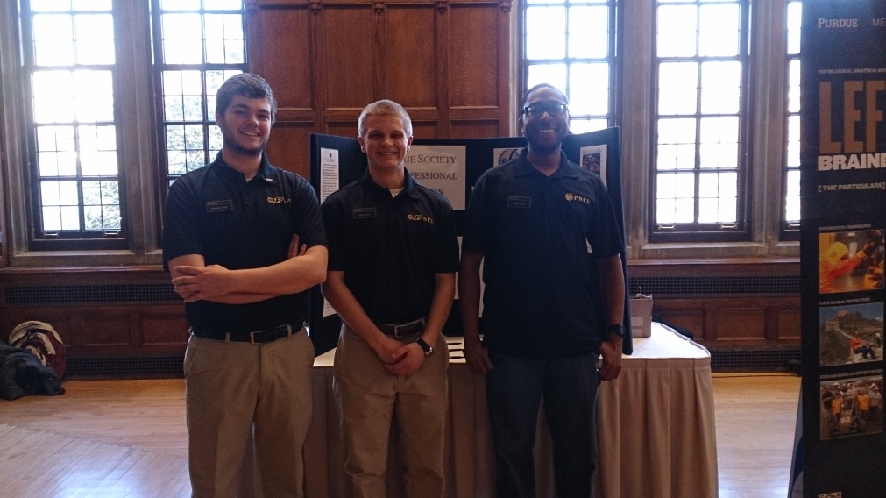
Order of the Engineer
Order of the Engineer Ceremony
Subcommittee within Events
Graduating or previously graduated engineers
Fall OE 12/14/14
Notes:
Speaker: Udit

Slide 9

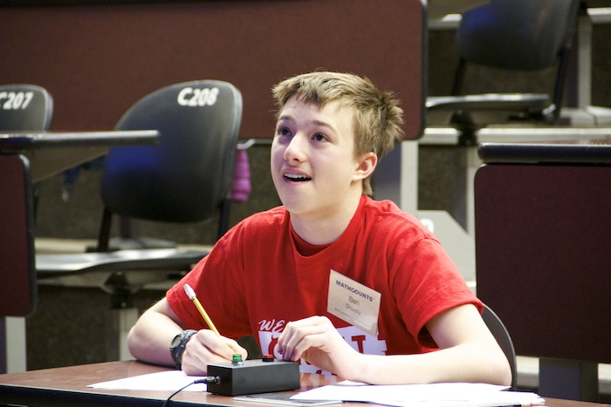

A regionals and state
Promotes middle school math
Volunteer opportunity (60)
Spring semester
Notes:
Speaker: Udit
It is a great opportunity to get involved with the community (we need 60 volunteers), low time commitment, encourage youth to get into STEM careers

Slide 10
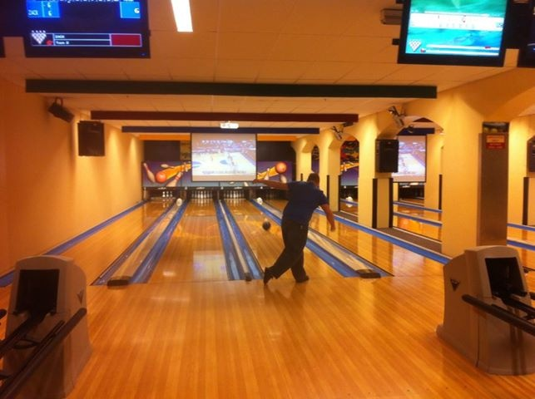

Service/Social Committee
Coordinates all social events
Volunteer work around Lafayette/West Lafayette
MathCounts Competition
Notes:
Speaker: Andrew

Slide 11

Research Roundtable Committee
Organizes and runs annual RR fair
Connect with companies, professors, and graduates → research opportunities
Research Roundtable:
Career fair for those interested in research
Tues 11/11/14
PMU Ballroom
Last spring’s success
Future goals
Notes:
Speaker: Mayank

Slide 12


Purdue Society of Professional Engineers
Team
What is a Rube Goldberg machine?
It is a complex machine using various common everyday items in order to complete a fairly simple task.
Why should you join?
The PSPE Rube Goldberg team has a long history of thinking outside the box and taking the competition to the next level. The team is credited with the world’s largest Rube Goldberg machine (2012). Last year we were on Discovery Channel, WLFI (channel 18), and after winning nationals, we were featured on Jimmy Kimmel Live!

Slide 13
Purdue Society of Professional Engineers
Team
When?
Thursday, September 4th 6:00 pm and 7:00pm HAMP 1252
Can’t make it ? Have questions?
Go to our website: http://web.ics.purdue.edu/~pe/index.html
Email me Jordan Vallejo jvallejo@purdue.edu

Slide 14
PSPE and You
Notes:
Speakers: Morgan
Transition slide, this section details how to actually get involved with PSPE

Slide 15





How can PSPE benefit you?
Leadership
Networking: company, professors, students
Preparation for FE Exam and professional licensure
Automatic student membership for NSPE and ISPE
Great resume booster
Notes:
Speaker: Morgan

Slide 16
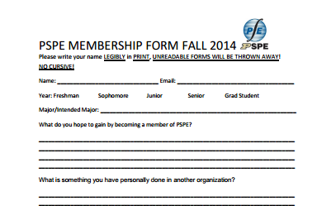
How can I join?
Applications:
Due Friday 10/3/2014 at 6:30pm in HAMP 1250
More on our website: www.engineering.purdue.edu/PSPE/
Membership Dues:
$15 for the semester
$25 for the year
Turn in dues with application
Must be an engineering student
NSPE and ISPE info given after joining
Notes:
Speaker: Jon

Slide 17
Fall 2014 Office Hours
Our office is located in HAMP 1250
Hours: 1:30-3:30pm Mon-Fri
Email us at pspe@ecn.purdue.edu if you would like to schedule an appointment outside of these times
Notes:
Speaker: Kyle

Slide 18
Contact us!
Our office: HAMP 1250
Our website: engineering.purdue.edu/PSPE/
Our email: pspe@ecn.purdue.edu
PSPE Rube Goldberg: web.ics.purdue.edu/~pe/
Twitter: @PurdueSPE
BoilerLink (GetInvolved): boilerlink.purdue.edu/organization/pspe
Notes:
Speaker: Riley

Slide 19
Thank you all for coming!!!
Don’t forget to swipe your ID card up front, and grab a membership form!!
Notes:
Speaker: Riley

